Slide 1
Arista Programmability
eAPI | EosSdk | Python | PowerShell | C++

Slide 2
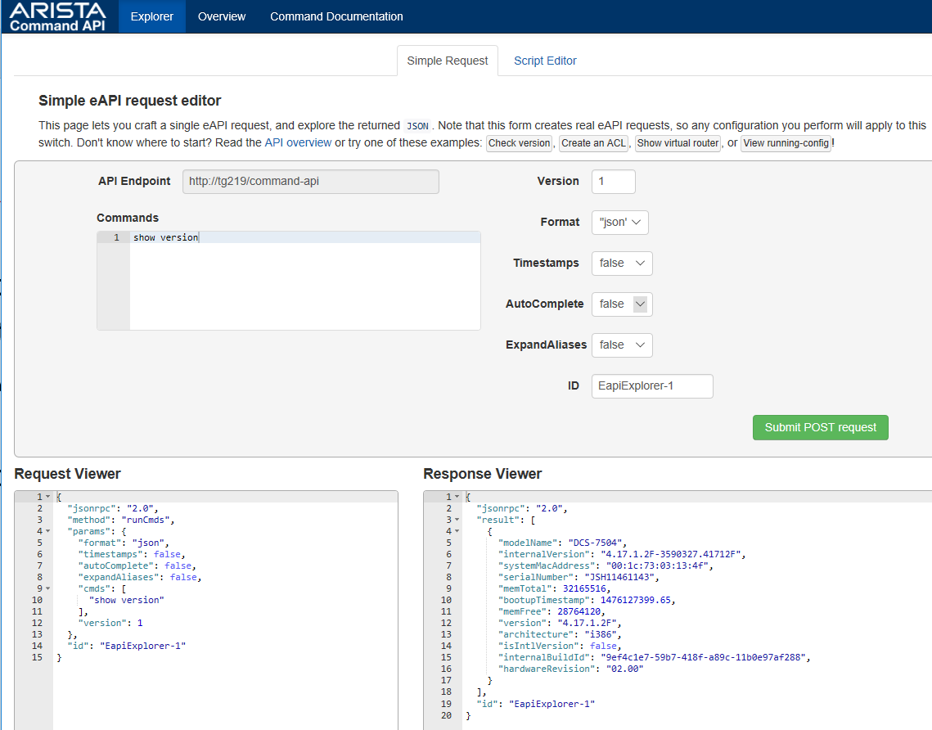
eAPI: Basic Operation
Step 1: Enable eAPI + Bonus (in)security settings
Step 2: Verify on-switch @ http://<switch-addr>/explorer.html
aaa authorization exec default local
aaa authentication policy local allow-nopassword-remote-login
!
username admin privilege 15 role network-admin
!
management api http-commands
protocol http
no shutdown

Slide 3
eAPI: Switch Based Script Editor
Edit JavaScript inline
Fully functional
Provide more advanced playground for testing with eAPI
Good reference if you know JavaScript
Further reading: http://<switch-addr>/main.js

Slide 4
eAPI: Basic Python Usage
NO additional libraries are required!
endpoint ="http://{}/command-api".format(switch_addr)
payload = magic_payload_constructing_function(commands, **kwargs)
headers = {"Content-Type": "application/json"}
creds = (username, password)
req = urllib2.Request(endpoint)
req.add_header("Content-Type",)
password_manager = urllib2.HTTPPasswordMgrWithDefaultRealm()
password_manager.add_password(None, endpoint, creds[0], creds[1])
auth_manager = urllib2.HTTPBasicAuthHandler(password_manager)
opener = urllib2.build_opener(auth_manager)
urllib2.install_opener(opener)
handler = urllib2.urlopen(req, data=payload)
See how easy that was!

Slide 5
eAPI: Basic Python Usage (Second try)
Install required additional libraries: requests (or jsonrpclib)
endpoint = "http://{}/command-api".format(switch_addr)
payload = magic_payload_constructing_function(commands)
headers = {"Content-Type": "application/json"}
creds = (username, password)
# now make the request.
requests.post(endpoint,
auth=creds, headers=headers, data=payload)
Take away: don’t bother with urllib2 – use a wrapper like ‘requests’

Slide 6
Escaping from the CLI

Slide 7
Handling eAPI Responses
All eAPI responses are JSON formatted

Slide 8



eAPI: Handling Errors
Traceback (most recent call last):
File "eapi_client.py", line 372, in <module>
main()
File "eapi_client.py", line 356, in main
response = client.send(commands)
File "eapi_client.py", line 290, in send
return response["result"]
KeyError: 'result'
Traceback (most recent call last):
File "eapi_client.py", line 372, in <module>
main()
File "eapi_client.py", line 356, in main
response = client.send(commands)
File "eapi_client.py", line 288, in send
raise EapiException(response["error"]["message"])
__main__.EapiException: CLI command 1 of 1 'show venison' failed: invalid command

Slide 9
Raising and Catching Exceptions

Slide 10
PowerShell

Slide 11
EOSSDK
What for? An on-box agent to handle events (a reactor)
Examples
Stream counters (see TerminAttr)
Make run-time changes to routing tables, ACLs, etc.
Reacting to congestion or denial of services attacks…
Now I’m rambling… Just look here: https://github.com/aristanetworks/EosSdk/wiki

Slide 12
EOSSDK: Hello World
Let’s stick to python for now…

Slide 13
EOSSDK: A More Useful Example?

